Slide 1
AWS VPC (Virtual Private Cloud)
Building Secure and Scalable Cloud Networks

Slide 2
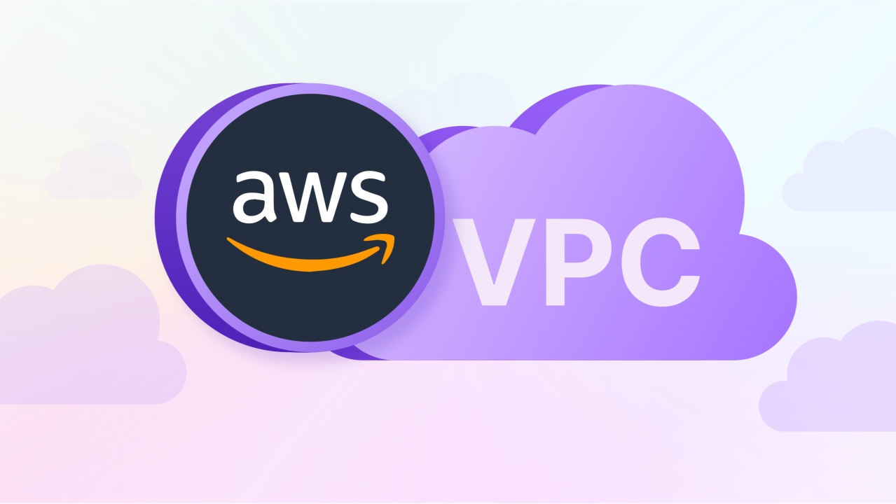
What is Amazon VPC?
Amazon Virtual Private Cloud (VPC) is a logically isolated section of the AWS Cloud where you can define your virtual network.
Purpose:
Launch AWS resources in a secure and controlled environment.
Customize networking to meet specific requirements.
Use Cases:
Hosting web applications securely.
Extending on-premises data centers to the cloud.
Creating multi-tier architectures.

Slide 3

Key Benefits of Amazon VPC
Isolation: Fully isolate resources for enhanced security.
Flexibility: Customize IP addressing, subnets, and routing.
Security: Leverage security groups and network ACLs.
Scalability: Expand resources as needed without manual reconfiguration.

Slide 4
Core Components of a VPC
Subnets: Public and private sub-networks within a VPC.
Route Tables: Rules for directing traffic within the network.
Internet Gateway (IGW): Access the internet from your VPC.
NAT Gateway: Allow private instances to initiate internet connections.
Elastic IP (EIP): Static public IP for resources.

Slide 5
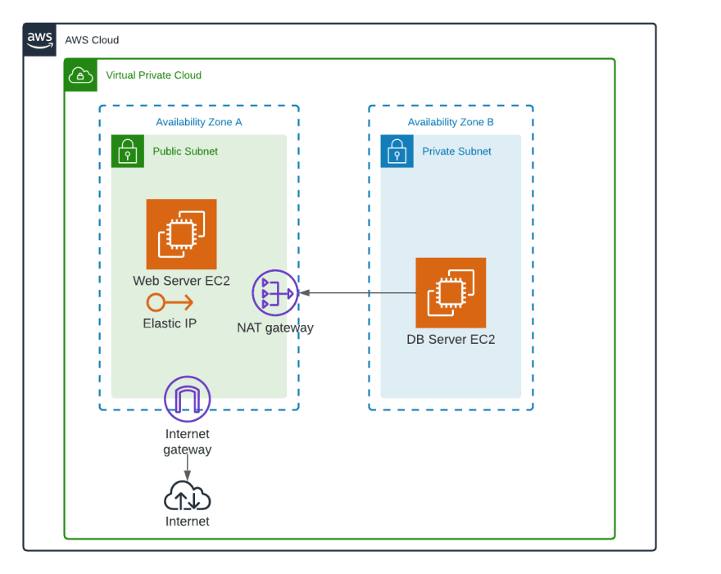
Public and Private Subnets
Public Subnet:
Direct internet access via the Internet Gateway (IGW).
Ideal for web servers and other public-facing resources.
Private Subnet:
No direct internet access.
Used for sensitive resources like databases and backend systems.

Slide 6
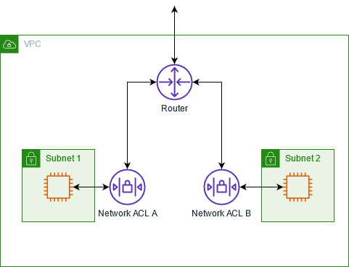
Security Features in VPC
Security Groups:
Instance-level firewall.
Controls inbound/outbound traffic.
Network ACLs (Access Control Lists):
Subnet-level firewall.
Allows/denies traffic at the subnet level.

Slide 7
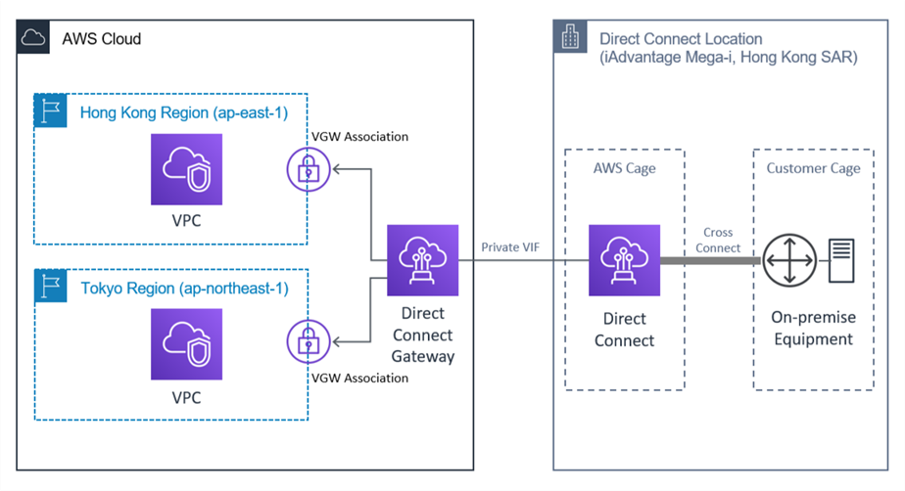
Connecting to VPC
Internet Gateway (IGW): Enables internet access for public subnets.
VPN and Direct Connect: Securely connect your on-premises network to AWS.
Peering Connections: Connect multiple VPCs for resource sharing.

Slide 8
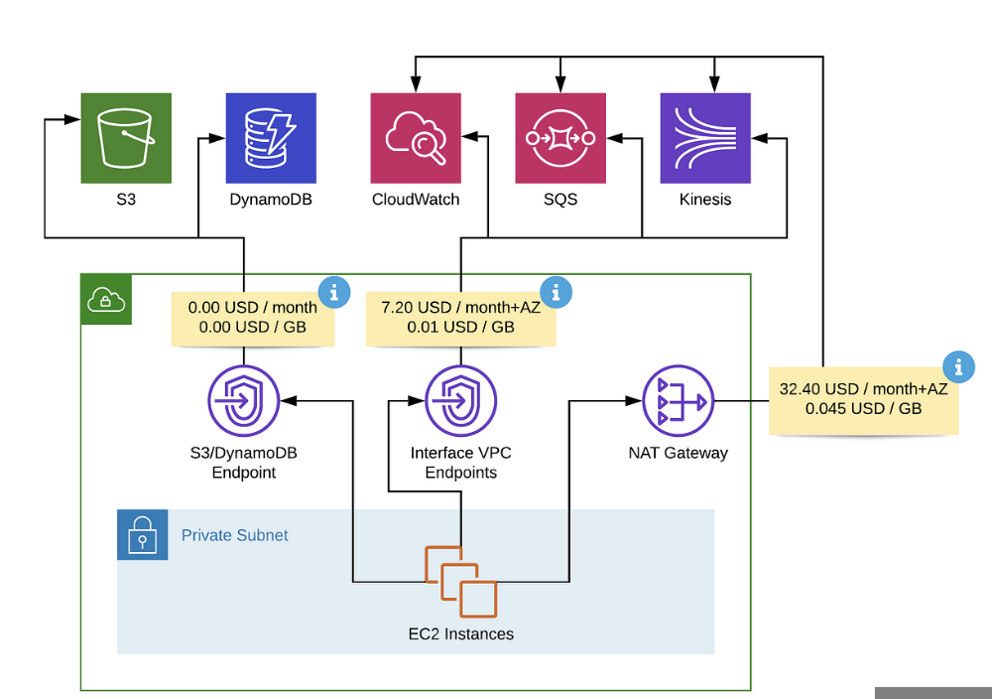
Advanced Networking in VPC
NAT Gateway: Allow instances in private subnets to access the internet without exposing them.
Elastic Load Balancer (ELB): Distribute traffic across instances in public and private subnets.
VPC Endpoints: Privately connect VPC to AWS services without using IGW or NAT.

Slide 9
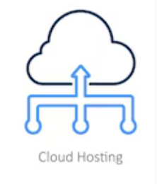
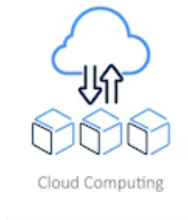

VPC Use Cases
Web Hosting: Deploy scalable, secure web applications.
Hybrid Cloud: Extend on-premises networks using VPN or Direct Connect.
Data Analytics: Run secure data analysis workflows.

Slide 10
VPC Best Practices
Design subnets for specific use cases (public, private, isolated).
Use least privilege principles with security groups and ACLs.
Monitor traffic using VPC Flow Logs.
Leverage NAT Gateways for secure internet access from private subnets.

Slide 11
Summery
VPC provides isolated, secure, and customizable networking in AWS.
Plan and design the VPC architecture based on application needs.
Utilize security and monitoring tools to safeguard resources.

